Slide 1
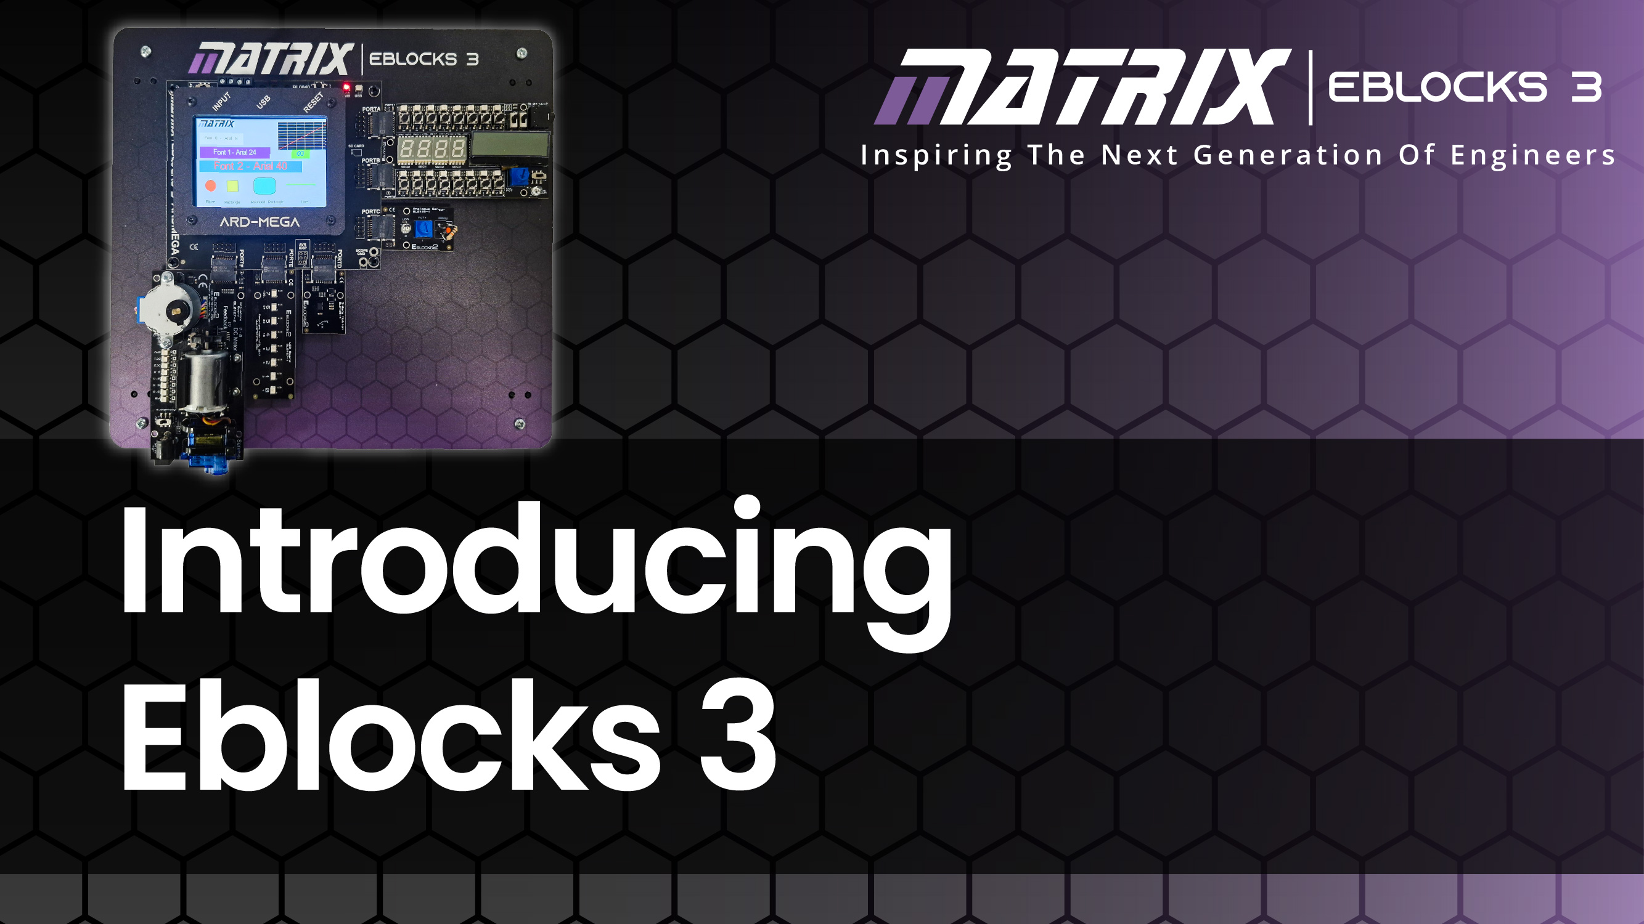
Microcontroller
Basics 2

Slide 2
Introduction
In this presentation we talk about:
How microcontrollers work
The analogue and digital world
What is inside a microcontroller
Microcontroller circuits
Microcontroller connections
Microcontroller internal peripherals
The capability of different microcontrollers
How you need to know the capability and pin connections of the microcontroller you use

Slide 3
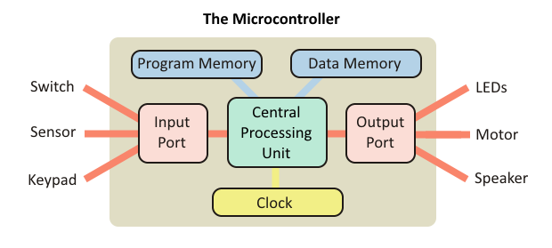
Introduction
Microcontrollers are tiny devices used to control other electronic devices. They are found in a huge range of products. In automotive systems they can be found in engines, anti-lock brakes and climate control systems. In domestic electronics they can be found in TVs, VCRs, digital cameras, mobile phones, printers, microwave ovens, dishwashers and washing machines.

Slide 4
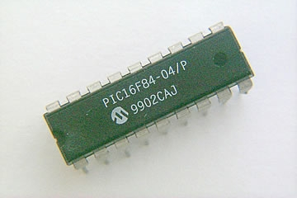
PIC and AVR/Arduino
The name PIC, (Peripheral Interface Controller), refers to a group of microcontrollers, produced by Arizona Microchip.
When we use a PIC microcontroller, we have to specify how we want the ports to behave. The ports are bi-directional, meaning that they can act as either input ports or output ports. When we write a program for the PIC, we start by configuring the ports, telling them whether they are to behave as input ports or output ports.
The input port can receive data (information) in one of two forms, as an analogue signal, or as a digital signal. It is important that we understand clearly the difference between these.

Slide 5
Much of our everyday information is described in numerical format.
For example:
• "It is 2 o’clock."
The digital world
"The temperature outside is 21 degrees C.“
"The car was travelling at 48 kilometres per hour.“
It is easy to understand data in this form.
For example, the table shows how the speed of a car changes over a period of time.
However, you might wonder what happened at time 35 seconds.
Was the car moving faster or slower than 25 km/h at that moment?
Time in seconds | Speed in kilometres per hour
0 | 0
10 | 15
20 | 21
30 | 25
40 | 22
50 | 20
60 | 16

Slide 6


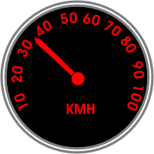
The analogue world
The hour glass egg timer: the greater the time elapsed, the deeper the sand in the bottom of the egg timer.
The mercury-in-glass thermometer: the hotter it gets, the further the mercury moves up the tube.
The car speedometer: the higher the speed, the further the pointer moves around the dial.
The problem with analogue data is that you have to do some work to extract it.
For the speedometer, and thermometer, you have to work out where the pointer sits on the scale. On the other hand, it is easy to judge how the temperature of a body or speed of a car is changing - watch how quickly the mercury is moving along the tube or how fast the pointer moves round the dial.

Slide 7
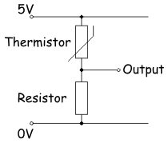
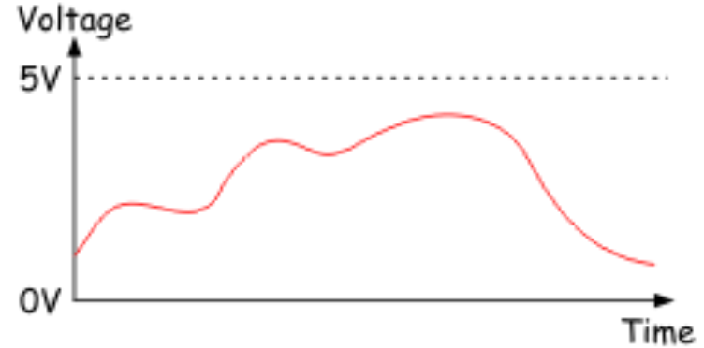
Analogue data
Many electronic sensors provide signals in analogue form. For example a temperature sensor
Here is the circuit diagram for one type of temperature sensor. The output voltage increases when the temperature increases.
It is an analogue signal because the voltage copies the behaviour of the temperature.
An electrical analogue signal can have any voltage value, limited only by the power supply used. In this case, the output of the temperature sensor could, in theory, go as high as 5V, or as low as 0V.
Over a period of time, the output voltage could change as shown in the diagram. This is an analogue signal.

Slide 8
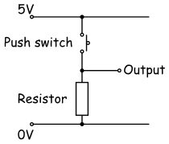
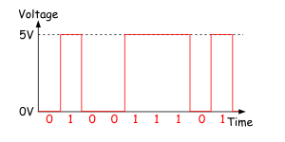
The analogue world
Electronic systems usually employ the binary number system, which uses only the numbers ‘0’and ‘1’, coded as voltages. We could decide on the following code: ‘0’= 0V, ‘1’= 5V, for example.
Digital signals, then, have only two possible voltage values, usually the power supply voltage, and 0V.
How can we enter these numbers into an electronic system?
One (very slow) way would be to use a switch (an example of a digital sensor.)
When the switch is open (not pressed,) the output is ‘pulled down’to 0V by the resistor. This output could represent the binary number ‘0’.
With the switch closed (pressed,) the output is connected to the positive supply, 5V in this case. This could represent the binary number ‘1’.

Slide 9
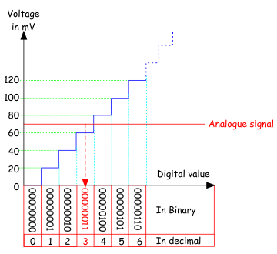
A/D converters
Much of our ‘real world’ data is analogue, but computers (including microcontrollers) can only process digital data. Microcontrollers contain a subsystem that can convert information from analogue format to digital format. This is called an Analogue-to-Digital Converter - usually shortened to ‘ADC’or ‘A/D’.
The ADC inside the a microcontroller divides the range of possible analogue voltages into equal steps.
The lowest step is given the number ‘0’, and the highest step is given the highest number that the A/D converter can handle.
This highest number is determined by the resolution of the ADC, which, in turn, depends on number of ‘bits’ the internal circuitry of the ADC can handle. The resolution of PIC ADCs is 8, 10 or 12 bit.

Slide 10
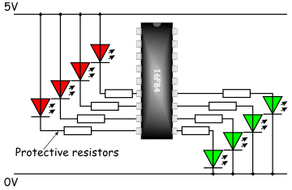
Outputting data
The microcontroller is a digital device. It outputs a digital signal. We use this to turn something on and off - ‘0’= ‘off’ and ‘1’= ‘0n’.
The diagram shows eight LEDs connected to a PIC16F84 microcontroller:
The four red LEDs are connected between the positive supply rail and the pins. For these LEDs, PIC is ‘sinking’ current.
The four green LEDs are connected between the pins and the 0V rail. For these, the PIC is ‘sourcing’ current.
Each red LED lights up when its pin is at a low voltage, outputting ‘0’in other words.
Each green LED lights when its pin is at a high voltage, outputting a ‘1’.

Slide 11
Current limits
Microcontrollers have limitations in terms of the output capabilities of the device.
Exceeding these limits, even for a short time, may cause permanent damage to the microcontroller.
The E-blocks 3 hardware has resistors which limit current on inputs and outputs.
Third party hardware may not have this protection.
Maximum current sunk/sourced by any I/O pin | 25mA
Maximum current sunk by all ports | 200mA
Maximum current sourced by all ports | 140mA
Maximum current out of VSS (Gnd) pin | 95mA
Maximum current into V_{DD} (5V) pin | 70mA

Slide 12
Storing data
Electronic sub-systems that store data are known as ‘memory’. They can store only digital data.
One item of data is stored in one location in the memory. This data could be the correct combination to disarm a burglar alarm, or the target temperature of a car engine block.
Each memory location has a unique address, a number used to identify the particular location. This means that we can draw up a map of the memory, showing what data is held in each location.
The decimal version of the address is included to make the table easier to read.
This very small memory has eight locations.
Address |  | Data stored
In decimal | In binary
0 | 000 | 11101001
1 | 001 | 00100101
2 | 010 | 10000101
3 | 011 | 11001101
4 | 100 | 01110100
5 | 101 | 00011011
6 | 110 | 11110011
7 | 111 | 10000101

Slide 13
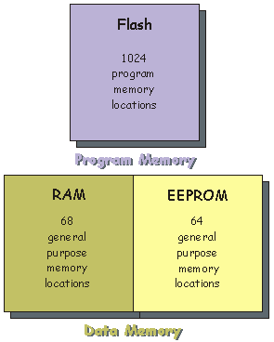
Types of memory
Program memory is used to store the program!
In most microcontrollers, such as the 16F18877, this uses ‘Flash’ technology, meaning that it can be programmed and cleared many times.
Data memory is used to store data! Part of this uses RAM and part uses EEPROM.
RAM allows both read and write operations during the running of a program.
The EEPROM allows us to preserve important data even if the power supply to the system is switched off.
For example, suppose that the PIC is part of a temperature controller that keeps an incubator at a set temperature. It might make sense to store the target temperature value in EEPROM so that we do not have to enter it into the system every time we switch the incubator on.

Slide 14
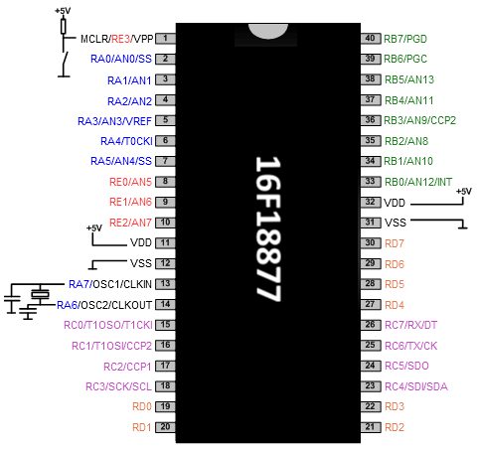
PIC microcontrollers
The PIC microcontroller is a digital device, but data can be entered in both analogue and digital forms. Programmers choose whether pins on the PIC are used as analogue inputs, digital inputs or digital outputs. This flexibility leads to complex labelling.
The diagram shows the pinout for a PIC 16F18877 chip. It has five ports, known as A, B, C, D and E. The pins on port A are labelled RA0 to RA7; pins on port B are labelled RB0 to RB7 etc. Ports A, B, C and D have eight pins but port E has only four.
For example, up to eight digital sensors can be connected to port A of the 16F18877.

Slide 15
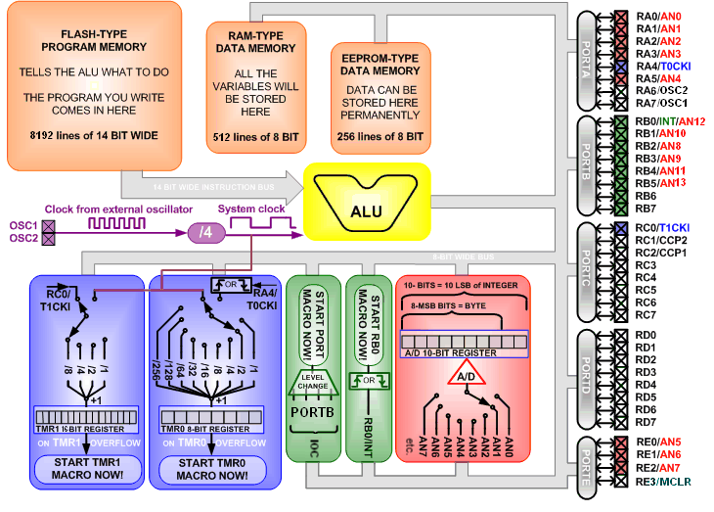
Microcontroller architecture
There are different types of microcontroller with different internal architectures.
The diagram shows the internal architecture of a PIC 16F877 microcontroller
You don't need to understand this in detail.
You do need to understand the input and output connections of the microcontroller, the memory available and the role of the internal peripherals in the microcontroller.

Slide 16
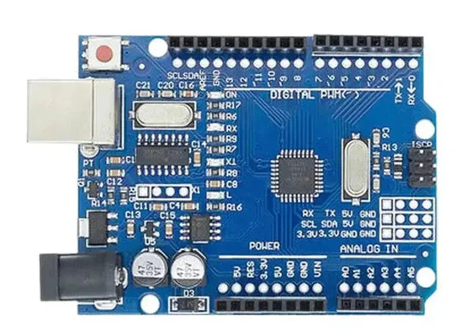
Arduino microcontrollers
Original Arduino microcontrollers were based on the 8 bit AVR microcontroller.
Arduino changed the pin numbering and presented the chip on a small PCB which saved set up time for hobbyists.
There are now many variants of Arduino boards with different features and capabilities.

Slide 17
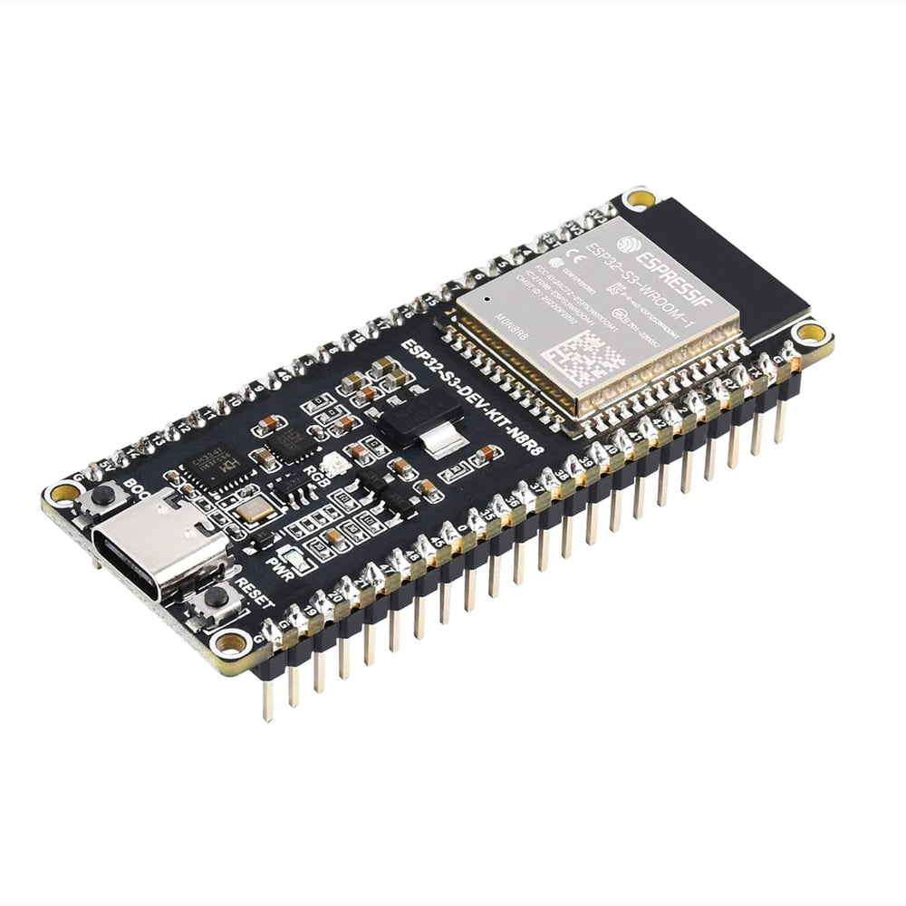
ESP32 microcontrollers
ESP32 microcontrollers use a 32 bit processor.
ESP32 has the great advantage that it includes Bluetooth and Wi-fi – so its great for web enabled projects.
Beware: the memory mapping and internal architecture means that this does not behave like a 8 bit system and this requires more experience to use.

Slide 18



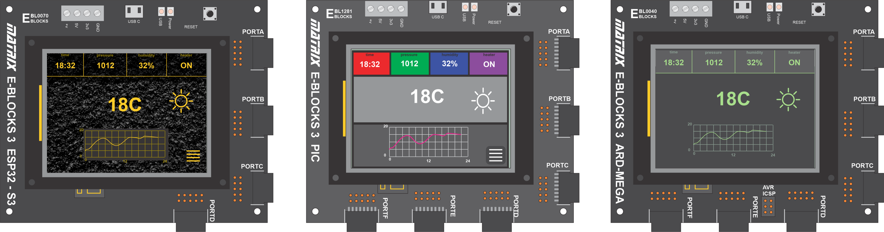
Microcontroller pins on E-blocks
ESP32S3 32 bit microcontroller
Digital I/O on all pins
A/D on all ports A and B
Motor function on all pins
Comms functions on all pins
Interrupts on all pins
PIC16F18877 8 bit device
Digital I/O on all pins
A/D on all pins
Motor/PWM function on most pins
Comms function on all pins
Interrupts on most pins
Arduino / AT 2650 8 bit device
Digital I/O on all pins
A/D only on port F
Limited motor/PWM support – see datasheet
Limited interrupt support

Slide 19
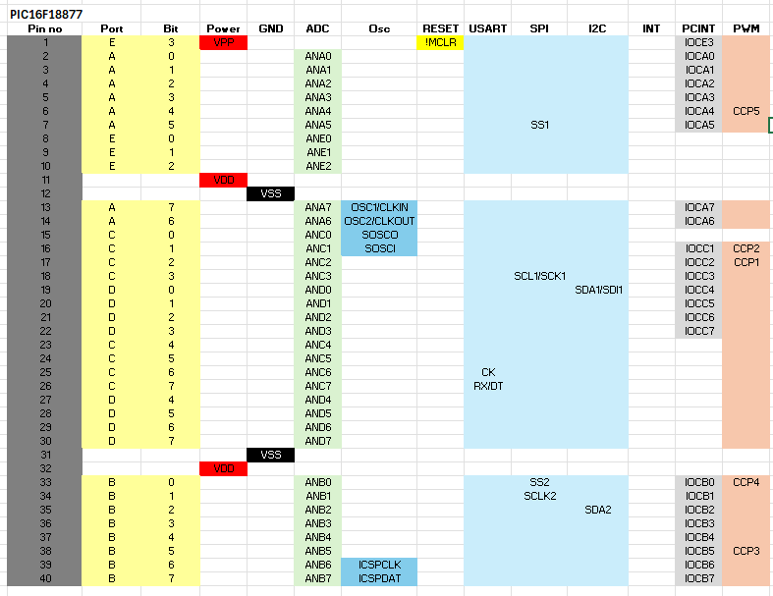
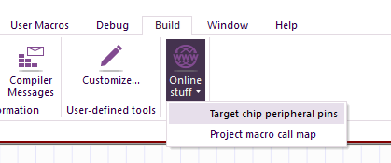
Microcontroller pin functions
Pin functions vary across microcontrollers. If you are only using digital input output then this is not a problem.
If you are using A/D, interrupts or motor functions then you need to be aware of the capabilities and pin connections of your microcontroller.
The examples in Flowcode show you the port connections for each example.
In Flowcode if you select ONLINE STUFF…TARGET CHIP PERIPHERAL PINSyou can see the capabilities of the chip you are using.
E-blocks 3 datasheet detail

Slide 20
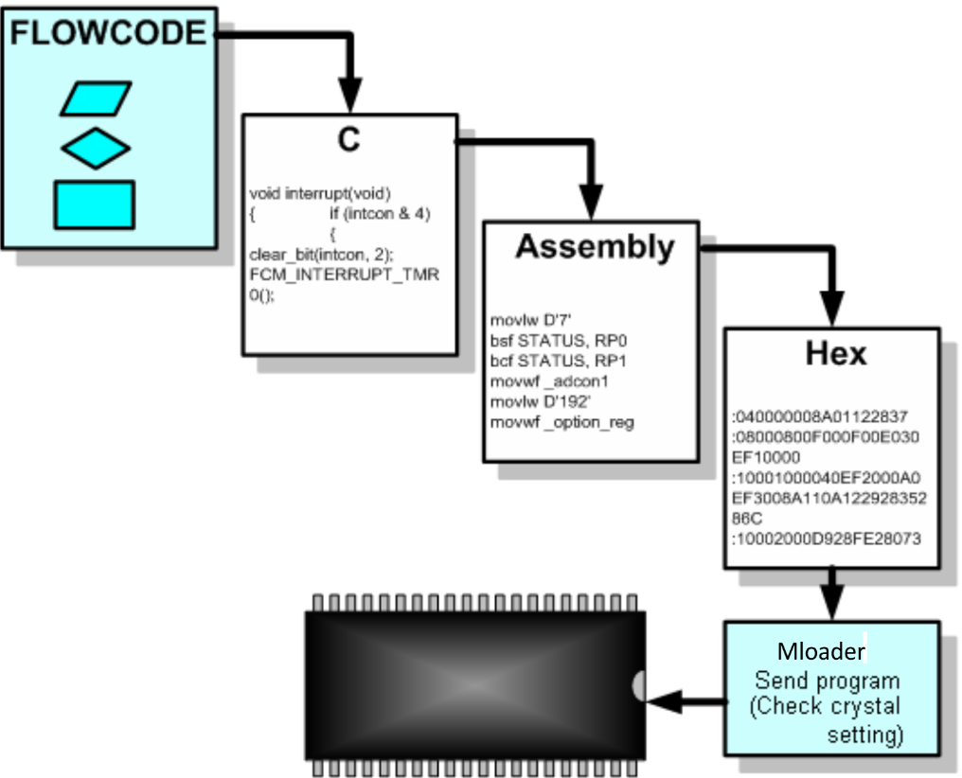
The Flowcode process
Flowcode offers an easy way to program microcontroller chips. Once the flowchart is designed on-screen, one press of a button causes the software to translate it into numerical code!
Flowcode passes the program through a number of processes before it gets sent into the microcontroller. The flowchart is processed:
first into C code,
then into Assembler,
and finally into hexadecimal numbers or ‘Hex’, which the microcontroller ‘understands’.
Flowcode allows you to use the same program on PIC, Arduino and ESP32 microcontrollers – you will need to change the pins and some internal peripheral settings.

